Slide 1
Advanced Programming Interfaces
Pieter Jorissen

Slide 2
Interfaces
An interface defines a contract
An interface is a type
Includes definitions for methods, properties, …
Interfaces provide no implementation
Any class implementing an interface must support all parts of the contract and therefore IMPLEMENT all methods/properties/…
Interfaces provide polymorphism
Many classes and structs may implement a particular interface
Notes:
In scenarios where completely different objects need to support some kind of shared functionality like, let’s say, persist to XML, classes can implement interfaces that make them compatible with even if they don’t share the same base class. This provides most of the benefits of multiple class inheritance without the nasty side-effects that this usually brings.
Interface members are implicitly public and abstract.

Slide 3
Interfaces
So in conclusion:
An interface is a class that has no implementation
It forces classes that implement that interface to provide for the implementation
Classes are allowed to implement more than one interface
Notes:
In scenarios where completely different objects need to support some kind of shared functionality like, let’s say, persist to XML, classes can implement interfaces that make them compatible with even if they don’t share the same base class. This provides most of the benefits of multiple class inheritance without the nasty side-effects that this usually brings.
Interface members are implicitly public and abstract.

Slide 4
Interfaces Example
public interface IDelete {
void Delete();
//NO IMPLEMENTATION HERE !!!
}
public class TextBox : IDelete
{
public void Delete() { ... }
}
public class Car : IDelete
{
public void Delete() { ... }
}
TextBox tb = new TextBox();
IDelete iDel = tb;
iDel.Delete();
Car c = new Car();
iDel = c;
iDel.Delete();
! implement every interface in a separate file just like classes

Slide 5
Interfaces Multiple Inheritance
Classes and structs can inherit from multiple interfaces
Interfaces can inherit from multiple interfaces
interface IControl
{ void Paint(); }
interface IListBox: IControl
{ void SetItems(string[] items); }
Class ComboBox: IControl, IListBox
{
void Paint() {…}
void SetItems(string[] items) {…}
}

Slide 6
Interfaces Explicit Interface Members
If two interfaces have the same method name, you can explicitly specify interface + method name to disambiguate their implementations
interface IControl
{ void Delete(); }
interface IListBox: IControl
{ void Delete(); }
interface IComboBox: IControl, IListBox
{
void IControl.Delete() {…}
void IListBox.Delete() {…}
}
Notes:
If there’s no ambiguity then you do not have to specify the name of the interface.

Slide 7
Interfaces: oefening
Implementeer een interface IAnimalTalk
Hierin definieer je:
Een readonly property Text die je een string returnt
Een method Speak
Daarna maak je Klasse Cat en Bird die beiden IAnimalTalk implementeren
Cat.Text returnt “miauw” en Bird.Text “tsjirp tsjirp”
Zowel Cat als Bird .Speak schrijft de return waarde van Text naar Console in de vorm van XX says YY
Dus “Cat says miauw” of Bird says “tsjirp tsjirp”
Test de werking uit in je main

Slide 8
Interfaces: advantange?
We can create lists/arrays,… from objects that all implement the same interface
We can loop through them and execute methods (that are part of the interface) and we will be sure that the implementation exists
What is the advantage over Inheritance?
You don’t need the “is a” relationship
You can implement from multiple interfaces (vs only inherit from one base class)

Slide 9
Interfaces: oefening
Pas je programma aan zodat je testobjecten in een collectie zitten
Loop door je collectie en voer de methode Speak uit

Slide 10
Interfaces: thuisoefening uitbreiding
Implementeer een nieuwe interface ILeggedAnimal
Deze definieert een property NumLegs en een methode WriteLegs
Deze property wordt in beide klasse geimplementeerd door het aantal poten naar console uit te schrijven
Test vanuit je main de werking

Slide 11
Interfaces: thuisoefening
Maak een interface IShape
Deze definieert Circumference (omtrek) en Area (oppervlakte)
Maak klassen voor Square, Circle en Triangle die IShape implementeren
Erf Rectangle over van Square en override beiden
Kies zelf de nodige variabelen, en test een lijst met verschillende shapes in.

Slide 12
Advanced Programming Design Patterns
Pieter Jorissen

Slide 13
Design Patterns
Are the answer to a question that commonly
arises “How can I … ?”
A design pattern is a time-tested solution to a common
Patterns enable a common design vocabulary, improving communication
Patterns capture design expertise and allow that expertise to be transferred

Slide 14
Types of Pattern
There are 3 types of pattern …
Creational: address problems of creating an object in a flexible way. Separate creation, from operation/use.
Structural: address problems of using OO constructs like inheritance to organize classes and objects
Behavioral: address problems of assigning responsibilities to classes. Suggest both static relationships and patterns of communication

Slide 15
Pattern Templates
Different authors use different templates to describe their patterns
Information is not always presented in the same way.
Consult your manual/source !!!
A typical template would be …

Slide 16
Pattern Templates
Name: meaningful text that reflects the problem, e.g. Bridge, Mediator, Flyweight
Problem addressed: intent of the pattern, objectives achieved within certain constraints
Context: circumstances under which it can occur, used to determine applicability
Forces: constraints or issues that solution must address, forces may conflict!
Solution: the static and dynamic relationships among the pattern components. Structure, participants, collaboration. Solution must resolve all forces!

Slide 17
Design Patterns
The idea was picked up by four authors: Erich Gamma, John Vlissides, Ralph Johnson, and Richard Helm. In 1995, they published Design Patterns: Elements of Reusable Object-Oriented Software, in which they applied the concept of design patterns to programming.
The book featured 23 patterns solving various problems of object-oriented design and became a best-seller very quickly. Due to its lengthy name, people started to call it “the book by the gang of four” which was soon shortened to simply “the GoF book”.
Since then, dozens of other object-oriented patterns have been discovered. The “pattern approach” became very popular in other programming fields, so lots of other patterns now exist outside of object-oriented design as well.

Slide 18
Design patterns
Read the info on this link:
https://refactoring.guru/design-patterns/

Slide 19
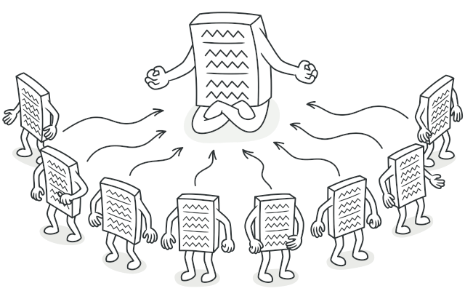
Singleton
Singleton is a creational design pattern that lets you ensure that a class has only one instance, while providing a global access point to this instance.

Slide 20
Singleton Problem
The Singleton pattern solves two problems at the same time, violating the Single Responsibility Principle:
Ensure that a class has just a single instance. Why would anyone want to control how many instances a class has? The most common reason for this is to control access to some shared resource—for example, a database or a file.
Here’s how it works: imagine that you created an object, but after a while decided to create a new one. Instead of receiving a fresh object, you’ll get the one you already created.
Note that this behavior is impossible to implement with a regular constructor since a constructor call must always return a new object by design.

Slide 21
Singleton Problem
Provide a global access point to that instance. Remember those global variables that you (all right, me) used to store some essential objects? While they’re very handy, they’re also very unsafe since any code can potentially overwrite the contents of those variables and crash the app.
Just like a global variable, the Singleton pattern lets you access some object from anywhere in the program. However, it also protects that instance from being overwritten by other code.
There’s another side to this problem: you don’t want the code that solves problem #1 to be scattered all over your program. It’s much better to have it within one class, especially if the rest of your code already depends on it.

Slide 22
Singleton Solution
All implementations of the Singleton have these two steps in common:
Make the default constructor private, to prevent other objects from using the new operator with the Singleton class.
Create a static creation method that acts as a constructor. Under the hood, this method calls the private constructor to create an object and saves it in a static field. All following calls to this method return the cached object.
If your code has access to the Singleton class, then it’s able to call the Singleton’s static method. So whenever that method is called, the same object is always returned.

Slide 23
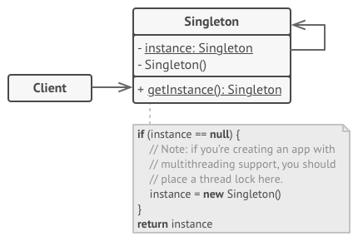
Singleton Solution

Slide 24
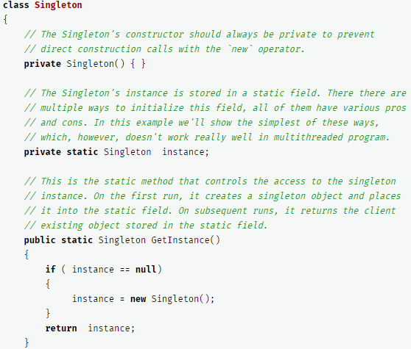
Basic Solution example

Slide 25
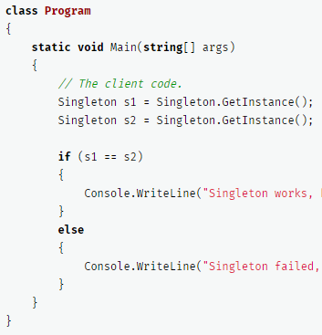
Basic Solution example

Slide 26
Thread safety!!!
The same class behaves incorrectly in a multithreaded environment. Multiple threads can call the creation method simultaneously and get several instances of Singleton class.
To fix the problem, you have to synchronize threads during the first creation of the Singleton object.
So you need to add a lock object

Slide 27
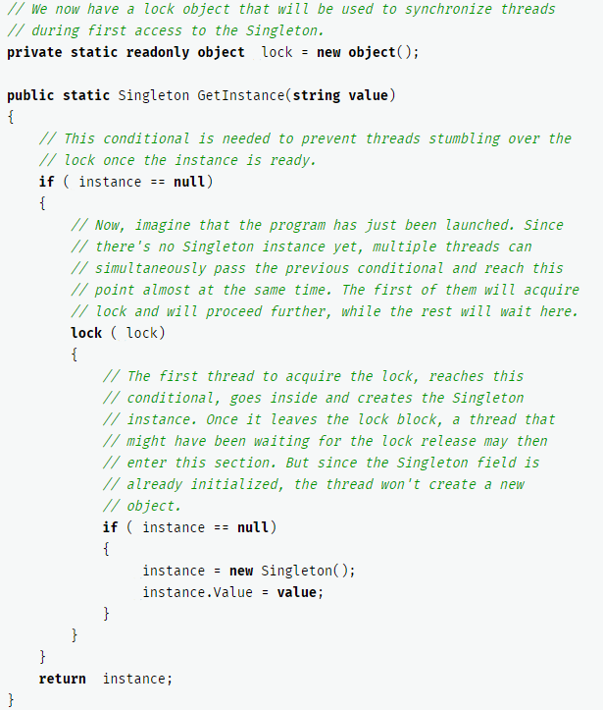
Thread Safe Singleton

Slide 28
Practical examples
Game Manager in unity
Audio Manager in Unity
GameSettings for a game
… anything you need exactly one of in your project and need to access from a lot of other different scripts/classes

Slide 29
Exercice 1: Singleton
Create a thread safe Singleton class for ConsoleManager and add thread safe a method WriteLine (which does a Console.writeline of a string parameter)
Create 2 classes that can start a thread
Keeps on prints out all alphabetical chars
The other prints out all numbers up to 100
Add a Start and Pause to both classes
In Main
Create 2 objects from those 2 classes
Run start their threads
Let it run for 5 seconds
Stop the threads and end the application
All console output from main also gets written via the ConsoleManager

Slide 30
Exercice: Singleton
Create a thread safe Singleton class for AudioManager and add thread safe a method PlaySound (use the SoundPlayer class from the System.Media namespace and play a .wav file from a parameter name)
Create a class LoopPlayer that can start a thread
Keep playing a wave file, every X seconds (X being a number that is passed to the constructor, pass a file path as well)
Print out “Playing filename” when the play starts
Add a Start and Pause method to the class
In Main
Create 2 objects of the LoopPlayer class, one that plays every 5 and one that plays every 12 seconds
Run start their threads
Let it run for 20 seconds
If you press ‘1’ you pause/restart the first thread, if you press ‘2’ you pause/restart the second thread

Slide 31
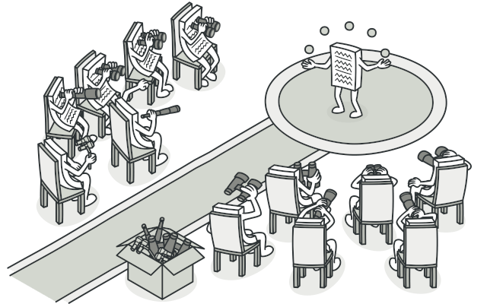
Observer pattern
Observer is a behavioral design pattern that lets you define a subscription mechanism to notify multiple objects about any events that happen to the object they’re observing.

Slide 32
Observer Problem
Imagine that you have two types of objects: a Customer and a Store. The customer is very interested in a particular brand of product (say, it’s a new model of the iPhone) which should become available in the store very soon.
The customer could visit the store every day and check product availability. But while the product is still en route, most of these trips would be pointless.

Slide 33
Observer Problem
On the other hand, the store could send tons of emails (which might be considered spam) to all customers each time a new product becomes available. This would save some customers from endless trips to the store. At the same time, it’d upset other customers who aren’t interested in new products.
It looks like we’ve got a conflict. Either the customer wastes time checking product availability or the store wastes resources notifying the wrong customers.

Slide 34
Observer Solution
The object that has some interesting state is often called subject, but since it’s also going to notify other objects about the changes to its state, we’ll call it publisher.
All other objects that want to track changes to the publisher’s state are called subscribers.
The Observer pattern suggests that you add a subscription mechanism to the publisher class so individual objects can subscribe to or unsubscribe from a stream of events coming from that publisher.

Slide 35
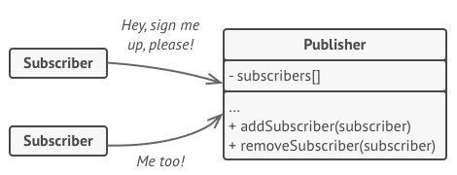
Observer Solution

Slide 36
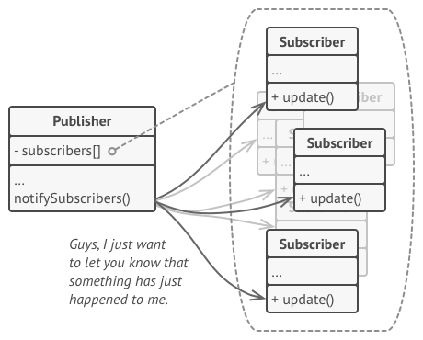
Observer Solution
whenever an important event happens to the publisher, it goes over its subscribers and calls the specific notification method on their objects

Slide 37
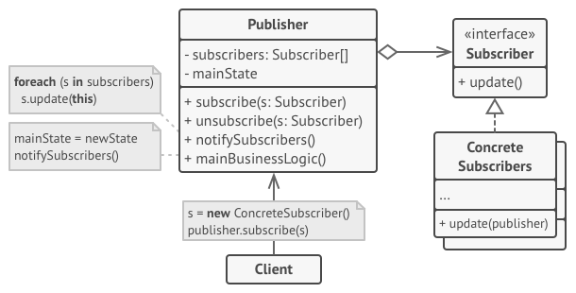
Observer Solution

Slide 38
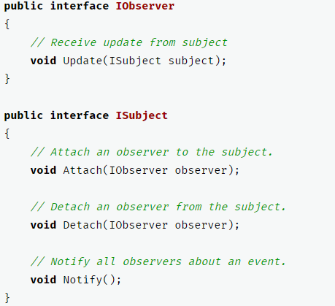
Observer example

Slide 39
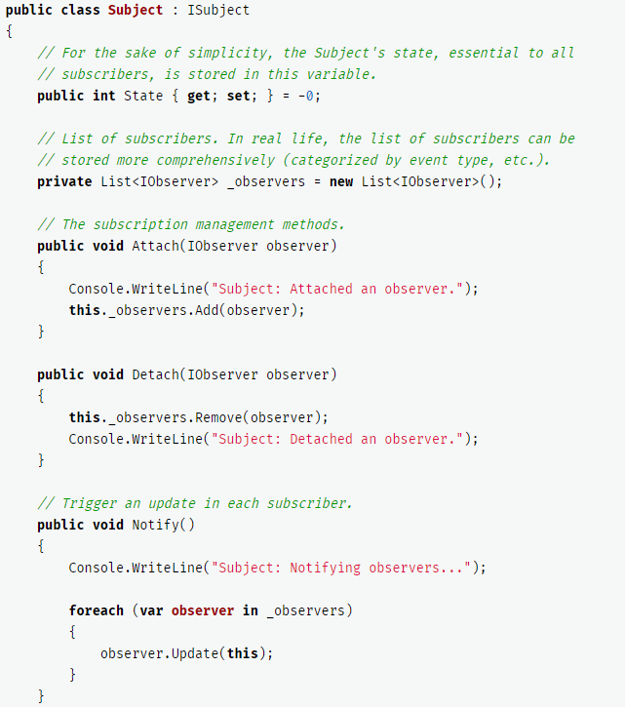
Observer example
…

Slide 40
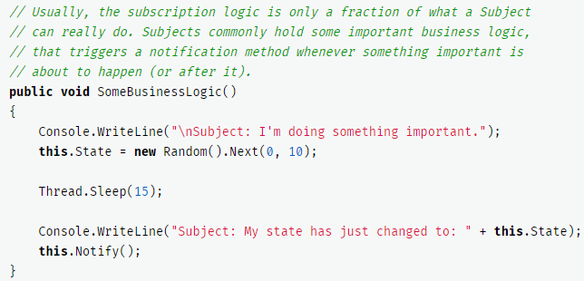
Observer example
…

Slide 41
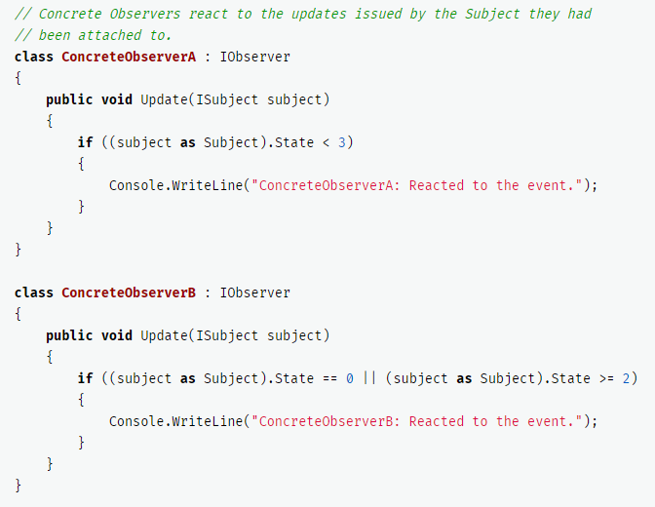
Observer example

Slide 42
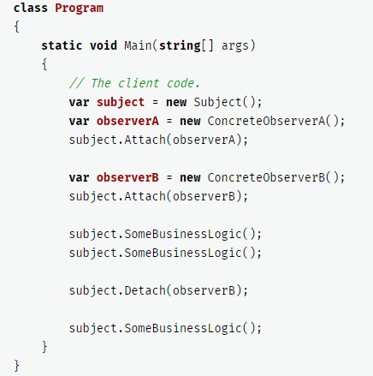
Observer example

Slide 43
Practical examples
All elements that need to updated when a bullet hit occurs (AudioManager, Score, LevelManager, Player…)
All elements that need te be updated when score changes (AudioManager, levelManager, DifficultyManager, UI elements, Enemies,…)
All elements that need te be updated when the player gains a new weapon/skill (Enemies, AI,interface, Inventory,…)
…

Slide 44
Exercise 2: Observer
Create an application for an auction
The Auctionioneer holds the current price and current bidder, and decides when a bid is accepted and the price raises
The bidders have a maximum bid and an augment amount, they raise every bid for as long as the current bid is higher than their own (and they didn’t bid they don’t hold the highest bid)
Let the bidders observe the auctioneer that starts with an opening bid.

Slide 45
Exercise 2: Observer
Create the observer pattern and add all bidders to it
Add a thread to every bidder so when StartBidding is called, they all start bidding as fast as possible (under the conditions stated before)
Make sure the observer is threadsafe
Make the auctioneer a singleton
Make sure that the Bid method in observer is threadsafe
Test using multiple bidders with different maximum amounts and write out all data

Slide 46
Design Patterns
Many more patterns exist
Look at the reference

